Slide 1

Exploring Spotify Data
Team 3 – Ian Robertson, Justine hughes, coina cepeda, Muhammad ramzan

Slide 2
Motivation and Summary
Set out to find a novel and wide-ranging topic that would appeal to a broad audience.
Did not want to choose such a unique area that our audience would not be familiar with the data.
Narrowed our search to music data. Specifically, Spotify data.
Spotify is a web and mobile based steaming application.
Streaming audio for music, podcasts, and videos around the globe.
Ending Q4 2020, Spotify had 155 million premium subscribers, making it the most used steaming service in the United States.
Spotify provides a free and accessible API.

Slide 3
Our Goal and Data
Questions to Answer: Hypothesis
Data Sources
Explore Spotify data to find possible explanatory data
What attributes or characteristics make a song popular?
How do we define popularity?
What trends, themes and patterns can we identify and analyze?
Spotify API
2020 Spotify streaming data (csv)
pre-determined Spotify variables
Weekly Spotify steam counts
provided by Spotify
period of 11/27/2020 – 12/31/2020
(all data sources can be referenced in github)

Slide 4
Top Songs of 2020 Analysis
Data Sources
Data Cleanup
transforming raw data
Data Analysis
turning data into information
Conclusions
what did we learn?
Postmortem
issues and difficulties
Spotify Quantitative Variables
Acousticness
Danceability
Energy
Instrumentalness
Liveness
Loudness
Speechiness
Tempo
Valence

Slide 5
Data Cleanup
using csv of Spotify data, we identified the top 200 songs of the year 2020 based on Spotify’s “popularity” metric.
cleaned data to identify null data values and to drop rows with missing data from our set.
Resulting in 198 complete rows and songs.

Slide 6
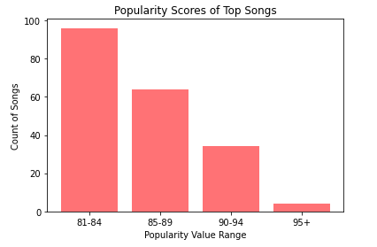
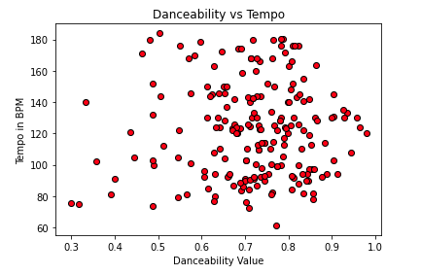
Data Analysis

Slide 7
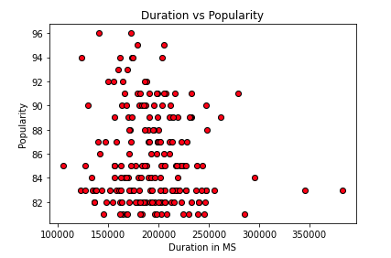
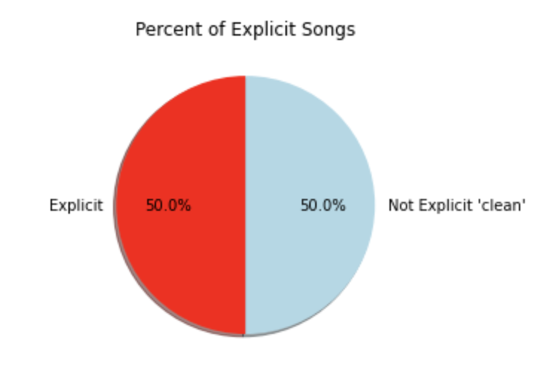
Data Analysis (con’t)

Slide 8
Discussion
conclusions
Postmortem
Explanatory relationships may be flawed by the existence of autocorrelation or serial correlation.
Limited by scope of data, only popular songs. Would comparison of not popular songs be useful? Or would it distort any relationships?
Qualitative data may be more useful (genre, artist, etc). Are these trends subject to any other sort of bias or issues? (cultural influences, year/decade).
The Spotify API was not as useful as we hoped. No steaming data directly from API. Main purpose is to apply Spotify to app/web development.
Popularity metric is only round (integer) numbers and no decimals (floats).
Music popularity may be too subjective to derive concise information from data.
Correlation does not mean causation.
Sample Size issues.

Slide 9

Christmas 2020
Wanted to run with original idea of discovering older tracks among current popular music
Unfortunately, Spotify API does not include streaming data
Is Christmas music popular enough on Spotify to show up at the top of the charts during the holidays?

Slide 10
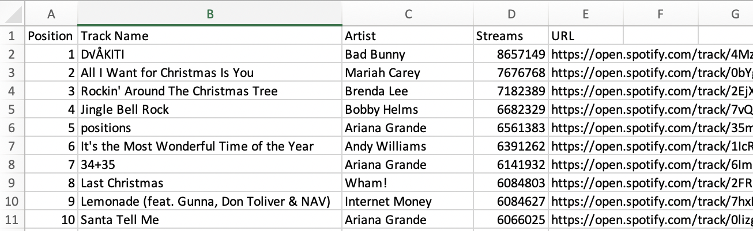
Data Cleanup
- 5 .csv files of the Top 200 US Spotify tracks for the weeks between 11/27/2020 – 12/31/2020 from SpotifyCharts.com

Slide 11
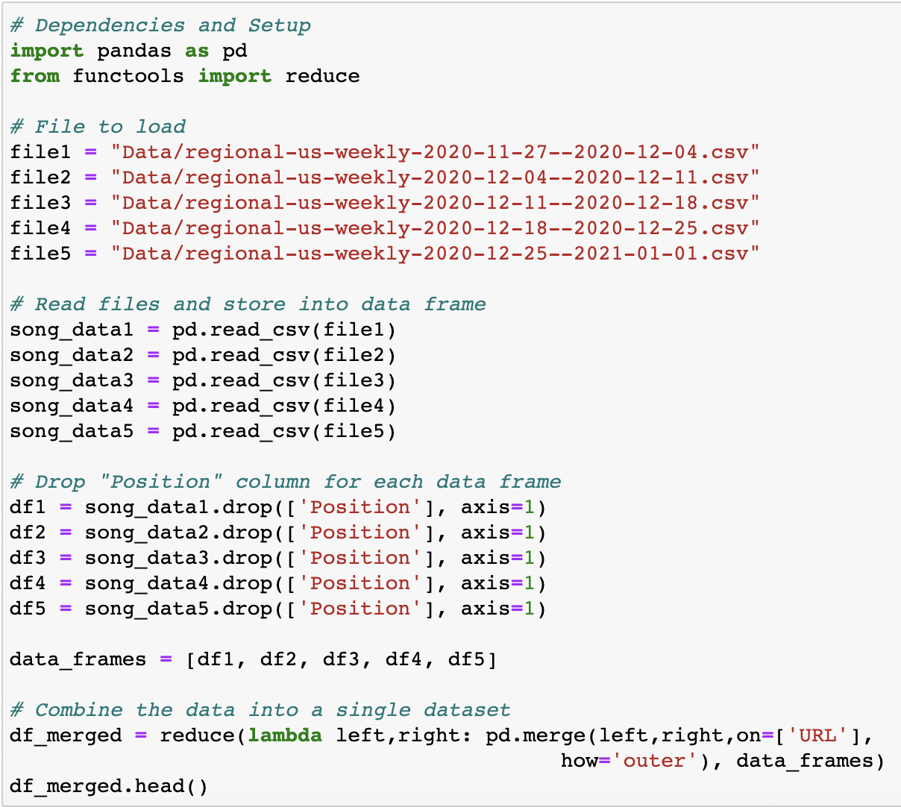
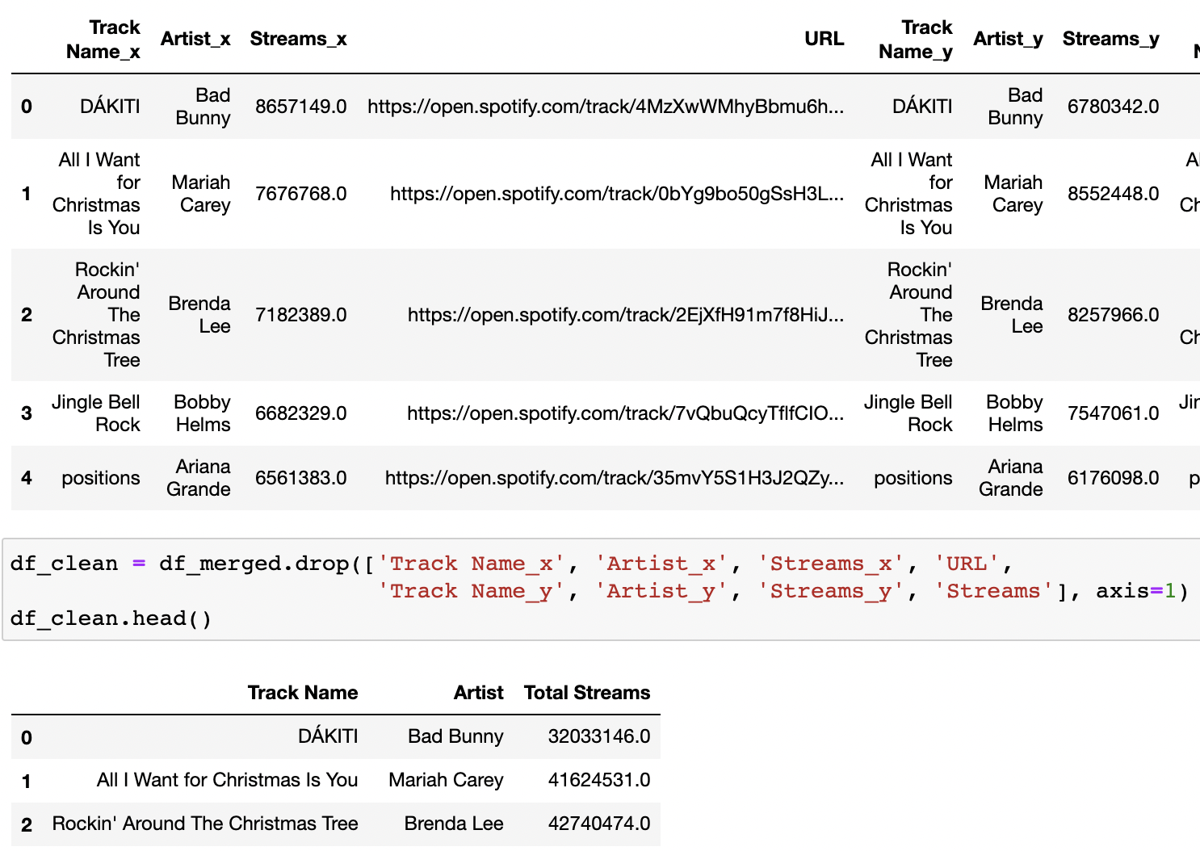
Data Cleanup (cont’d)

Slide 12
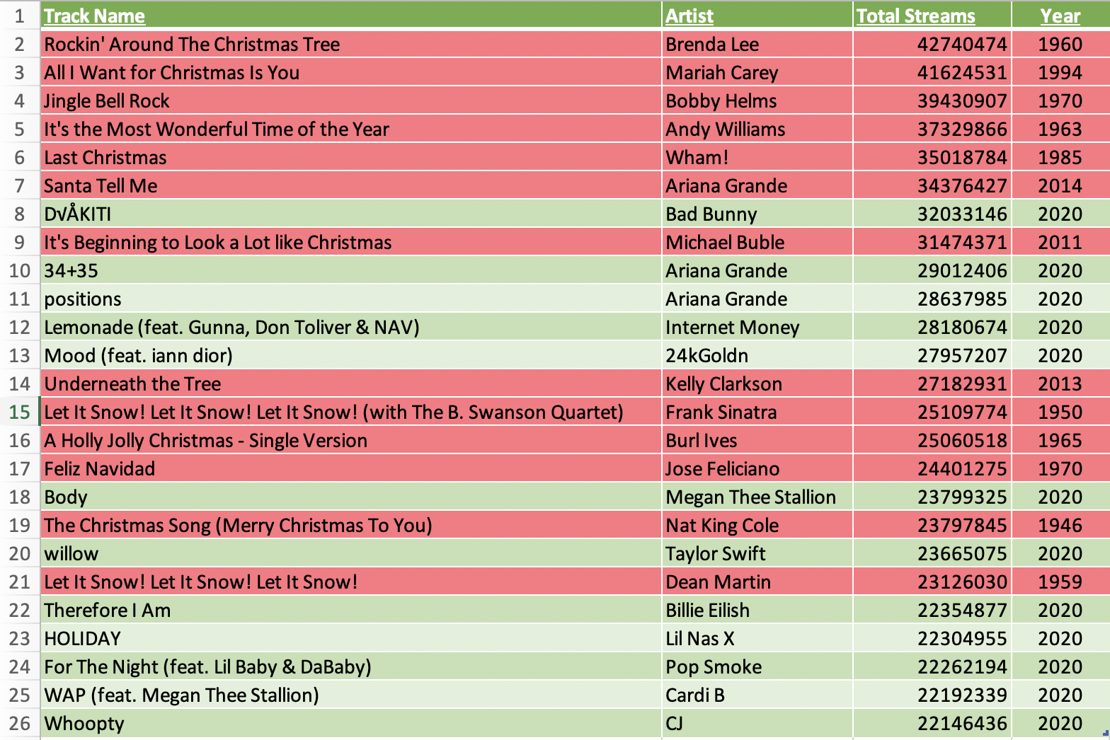
Top 25 Spotify Tracks: 11/27/2020 – 12/31/2020
- Analysis & Conclusions

Slide 13
Q&A
Thank you!

